Slide 1
Image Classification
Srujana Alajangi
Prashanth Kumar Manji

Slide 2
Presentation Infographics
01
Problem Statement
04
Transfer Learning
02
Image Classification
05
Results
03
06
CNN
Observations

Slide 3
Problem Statement
Image Classification using different Neural Networks and identify the best model.
Models Used
CNN
ResNet
VGG
EfficientNet
Dataset - CIFAR-10

Slide 4
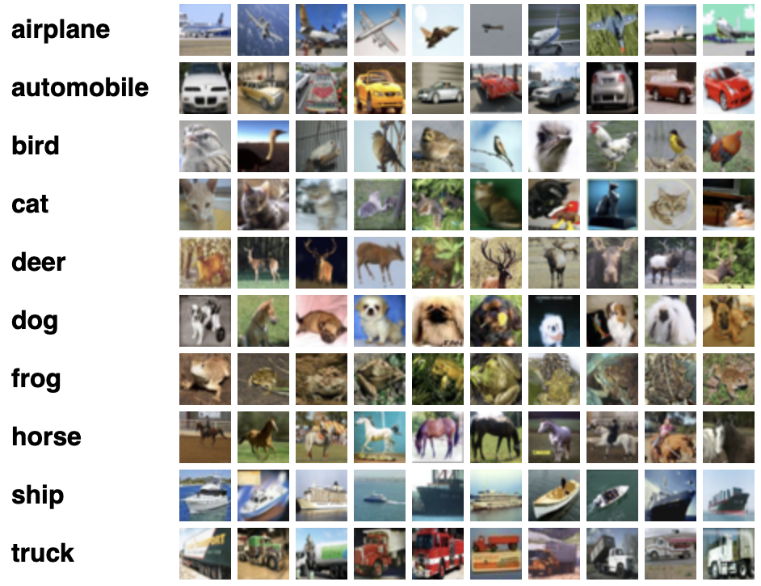
CIFAR-10
60000 Images
32*32 Size
10 Classes

Slide 5
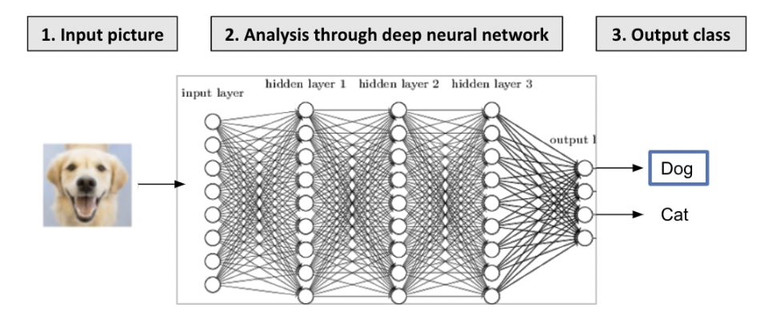
Image Classification
Image classification is where a computer can analyse an image and identify the ‘class’ the image falls under.
It is a supervised learning problem: define a set of target classes (objects to identify in images), and train a model to recognize them using labelled example photos.

Slide 6
Convolutional Neural Network (CNN)
A convolutional neural network (CNN) is a type of artificial neural network used primarily for image recognition and processing, due to its ability to recognize patterns in images.
Instead of preprocessing the data to derive features like textures and shapes, a CNN takes just the image's raw pixel data as input and "learns" how to extract these features, and ultimately infer what object they constitute.

Slide 7
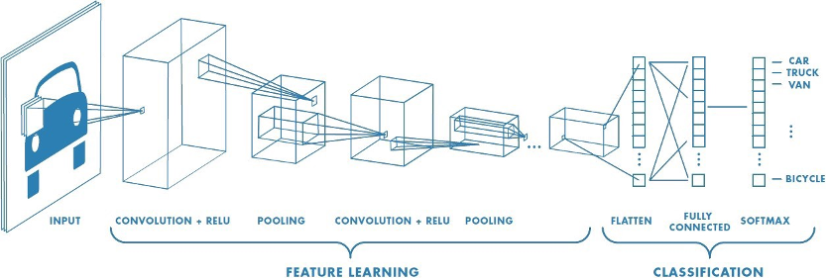
Convolutional Neural Network (CNN)

Slide 8
Different Layers in CNN
Convolutional layer: applies a filter to a patch of pixels and sums the results on the patch
The filter/kernel could be used to see if that patch of pixels has a line or not
Output of a convolution is referred to as a feature map
The model learns these filters during training
Pooling layer: sums/averages/takes-max values of a patch
Allows us to do something like “count” the number of lines in an area
Pooling layer representation is meant to vary little when elements in previous layer vary in position
Typically follows a convolutional layer
Fully-connected layer: used to classify the features for a final answer

Slide 9
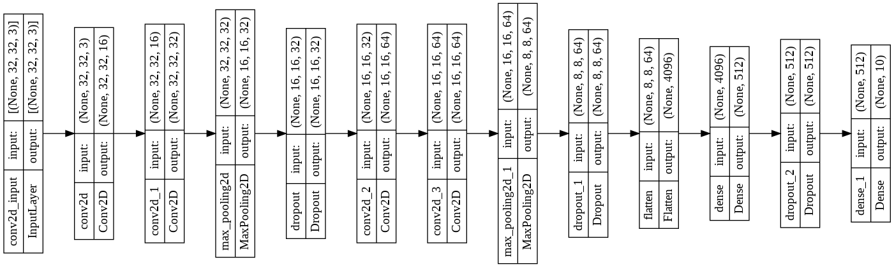
CNN Model

Slide 10
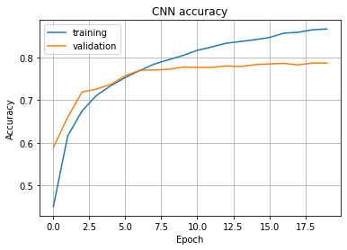
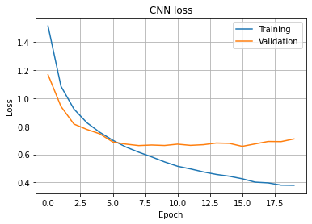
Convolutional Neural Network (CNN)

Slide 11
CNN
CNN advantages vs disadvantages
Advantages
Disadvantages
No human supervision
High accuracy at image supervision
Weight sharing
Minimize computation
Same knowledge across all image location
A lot of training data is needed
CNN tend to be much slower
Training process takes a long time
Fail to encode the position and orientation of objects

Slide 12
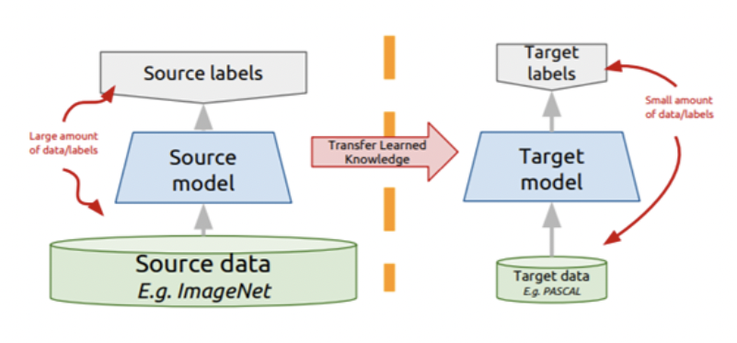
Transfer Learning
The knowledge of an already trained machine learning model is applied to a different but related problem.

Slide 13
ResNet
ResNet-50 is a 50-layer convolutional neural network (48 convolutional layers, one MaxPool layer, and one average pool layer)
ResNet-50 is a pre-trained Deep Learning model for image classification of the Convolutional Neural Network(CNN, or ConvNet), which is a class of deep neural networks, most commonly applied to analyzing visual imagery.
ResNet-50 is 50 layers deep and is trained on a million images of 1000 categories from the ImageNet database.
Furthermore the model has over 23 million trainable parameters, which indicates a deep architecture that makes it better for image recognition.

Slide 14
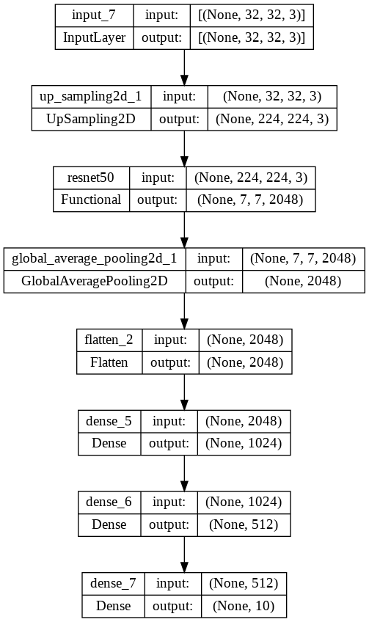
ResNet Model

Slide 15
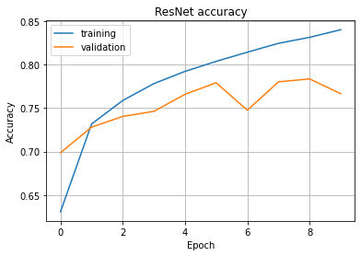
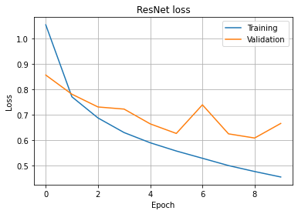
ResNet

Slide 16
ResNet advantages vs disadvantages
Advantages
Disadvantages
Easy to optimize
Training error doesn’t increase as the depth of the neural network increases
Reduces training time and improves accuracy.
For a deeper network, the detection of errors becomes difficult.
The learning might be very inefficient if the network is too shallow.

Slide 17
VGG
A VGG16 is a convolutional neural network trained on a subset of the ImageNet dataset, a collection of over 14 million images belonging to 22,000 categories.
The Keras VGG16 model is used in feature extraction, fine-tuning, and prediction models. By using Keras VGG16 weights are downloaded automatically by instantiating the model of Keras and this model is stored in Keras/model directory.

Slide 18
EfficientNet
An EfficientNet is a convolutional neural network architecture and scaling method that uniformly scales all dimensions of depth/width/resolution using a compound coefficient.
EfficientNet uses a technique called compound coefficient to scale up models in a simple but effective manner. Instead of randomly scaling up width, depth or resolution, compound scaling uniformly scales each dimension with a certain fixed set of scaling coefficients.
EfficientNet is based on the baseline network developed by the neural architecture search using the AutoML MNAS framework.

Slide 19
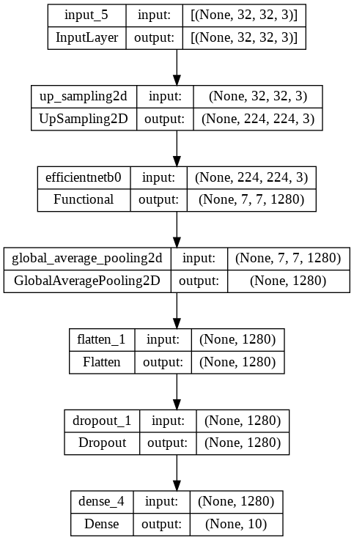
EfficientNet

Slide 20
Transfer learning advantages vs disadvantages
Advantages
Disadvantages
It will be very helpful when we have less amount of data
Helps to produce more accurate results
Speeds up the training process.
Problem of overfitting
Problem of negative transfer

Slide 21
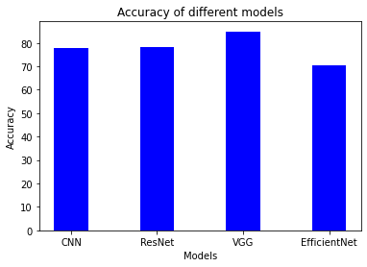
Accuracy Report
Model | Accuracy
CNN | 77.8
ResNet | 77.0
VGG | 84.9
EfficientNet | 70.4

Slide 22
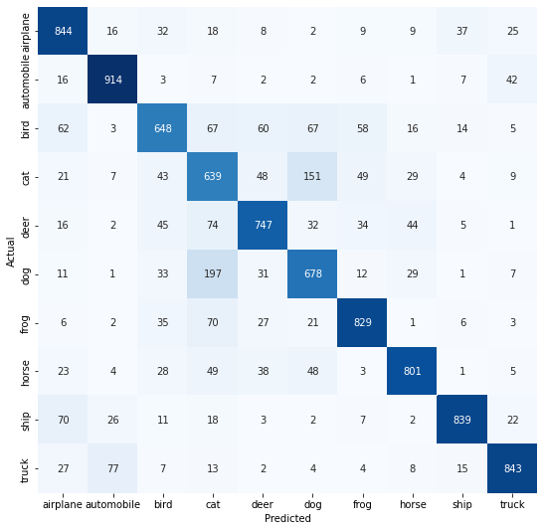
Confusion Matrix

Slide 23
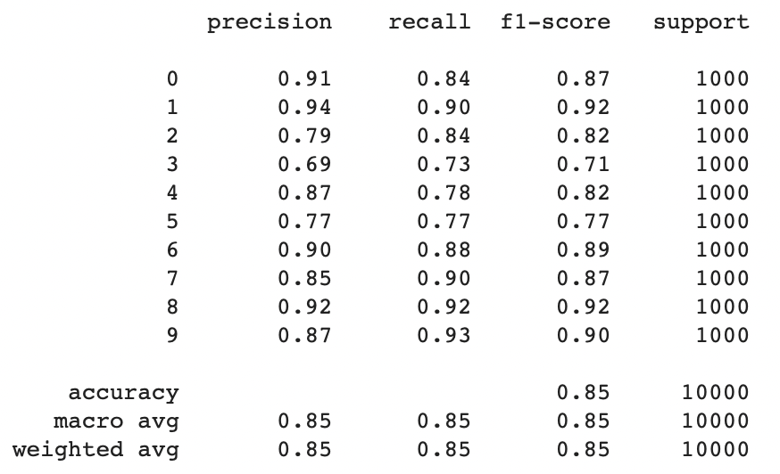
Classification Report

Slide 24
Use Cases of Image Classification
Cancer detection using x-rays
Face recognition in security
Visual Search for Improved Product Discoverability
Classifying a handwritten digit
Assigning a name to a photograph of a face

Slide 25
References
Yamashita, R., Nishio, M., Do, R.K.G. et al. Convolutional neural networks: an overview and application in radiology. Insights Imaging 9, 611–629 (2018). https://doi.org/10.1007/s13244-018-0639-9
https://www.thinkautomation.com/eli5/eli5-what-is-image-classification-in-deep-learning/
https://towardsdatascience.com/using-convolutional-neural-network-for-image-classification-5997bfd0ede4
https://www.learndatasci.com/tutorials/hands-on-transfer-learning-keras/
https://www.youtube.com/watch?v=b59xfUZZqJE&ab_channel=edureka%21
https://www.mygreatlearning.com/blog/object-detection-using-tensorflow/

Slide 26
Thank You!

